Slide 1

CIRCULAR
PARALLAX
ZOOM

Slide 2
CIRCULAR
PARALLAX
ZOOM

Slide 3
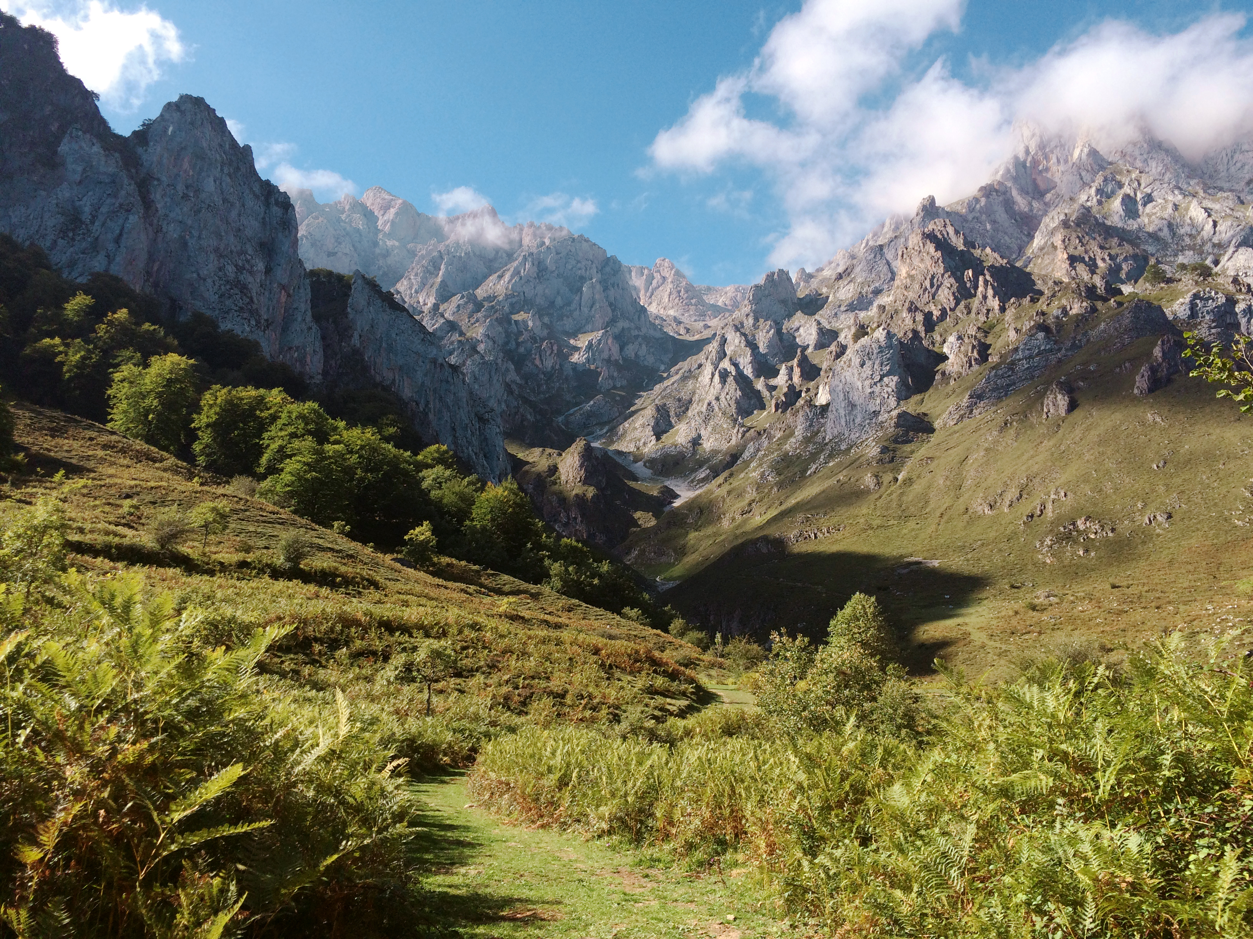
CIRCULAR
PARALLAX
ZOOM

Slide 4
CIRCULAR
PARALLAX
ZOOM

Slide 5
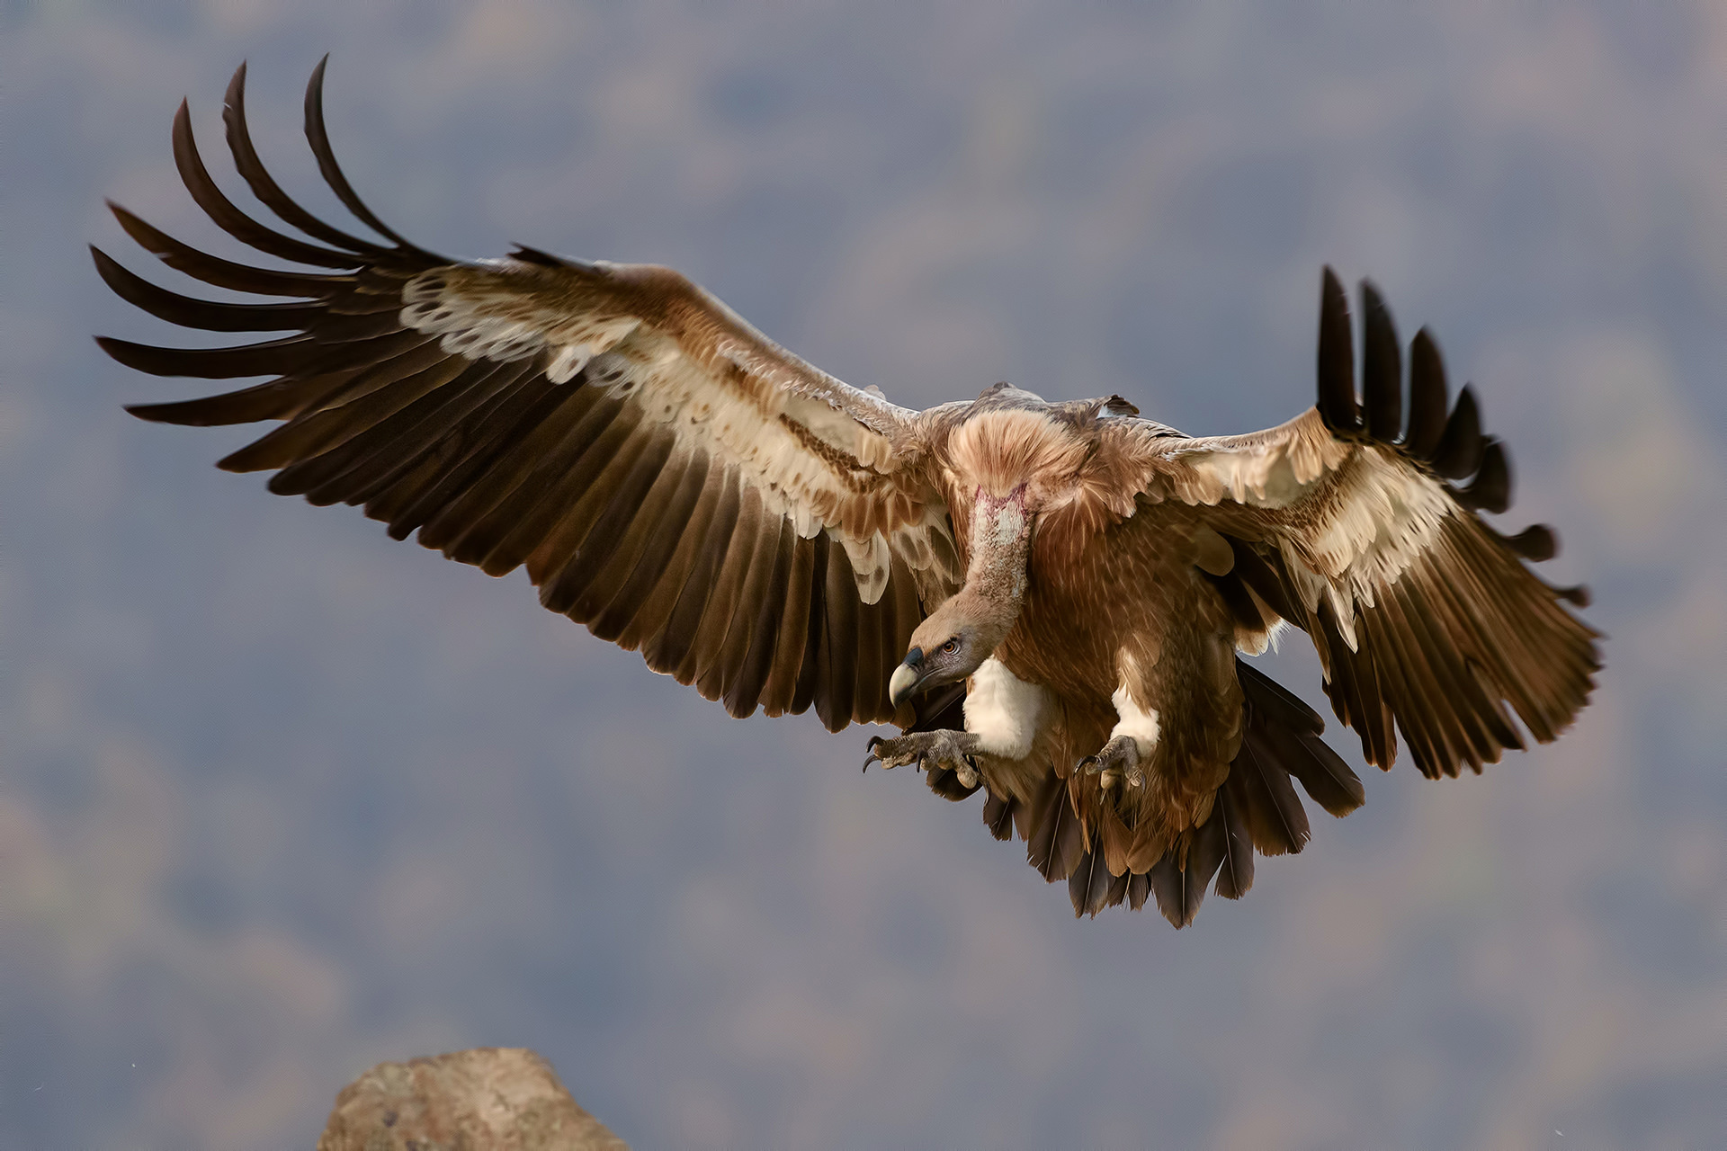
Take a
Closer
look

Slide 6
Take a
Closer
look

Slide 7

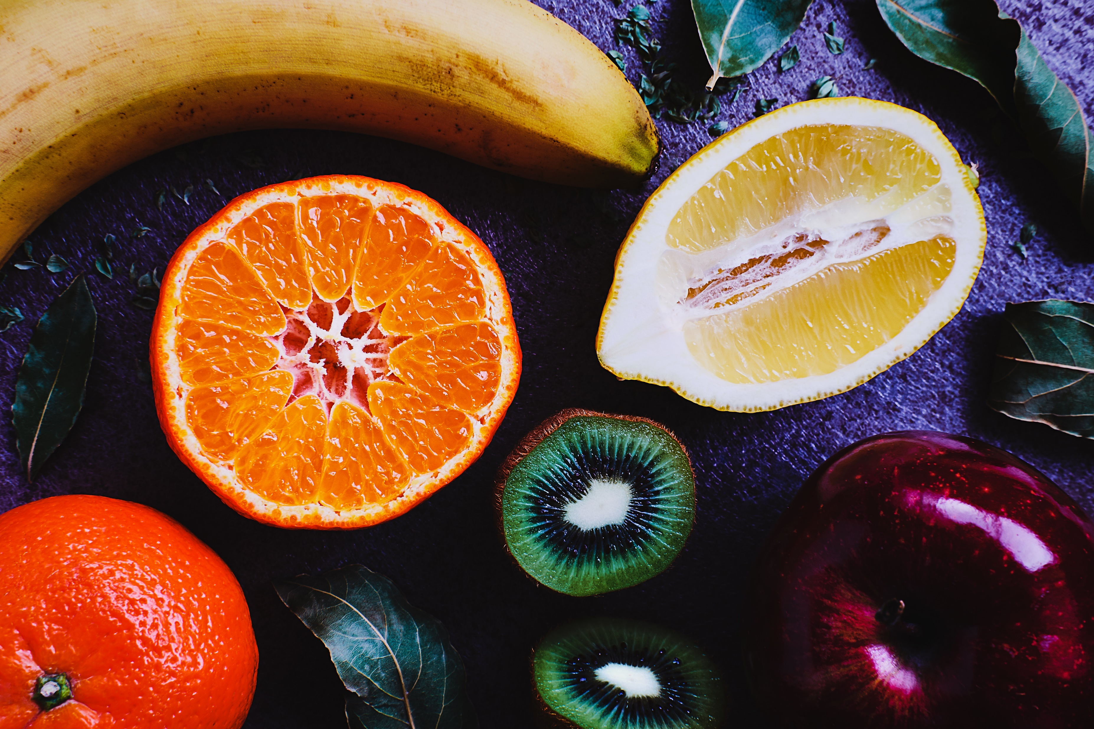
FEEL
THE
TASTE

Slide 8



FEEL
THE
TASTE

Slide 9

WRITE
IT
DOWN

Slide 10
WRITE
IT
DOWN

Slide 11

Sky is
The
limit

Slide 12
Sky is
The
limit

Slide 13

Let‘s
Make some
photos

Slide 14
Let‘s
Make some
photos

